Slide 1

ECHO

Slide 2

What is Aloha?
A SPLUNK Search Assistant both in VISUAL and AUDITORY
Syntax highlight for the Color Blindness
Voice Ctrl for user convenience

Slide 3
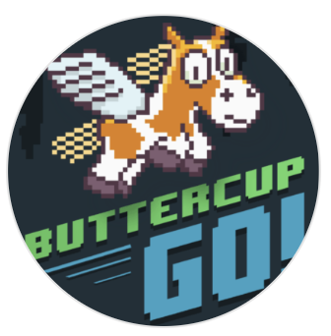
How it works?
I’m a Pure Frontend
Chrome Extension
for Splunk Search App
Key Takeaways:
NLP & KG
Soundex & Double-Metaphone
Levenshtein & LCS
Initialization based on
Splunk Server Data
&
NL dictionary
Speech
to
Text
Fuzzy Matcher
Working Mode
Recognition
DOM Injection
Answer generator
&
recommendation
Key Word
Recognition
Pipeline overview

Slide 4
Say ALOHA !

